Slide 1

FlowGov AI AI-Powered Workflow Optimization for Government File Processing
By – Parth Garg

Slide 2
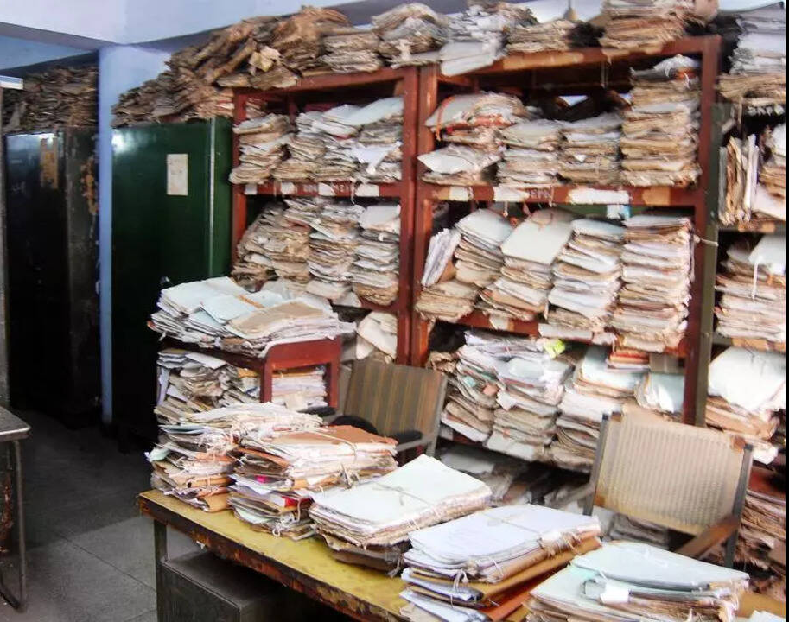
The Problem: Delays in Government File Processing
• Millions of files are processed every year across multiple government departments • Inefficient file routing and uneven workload distribution cause significant delays • These inefficiencies result in large backlogs that slow down decision-making • Kerala Finance Department (2024): 26,257 files remain pending • Across India: More than 4 lakh RTI appeals are awaiting resolution • From a citizen’s perspective, the system lacks transparency • Most users can only see a generic status such as “Pending at X office” only.

Slide 3
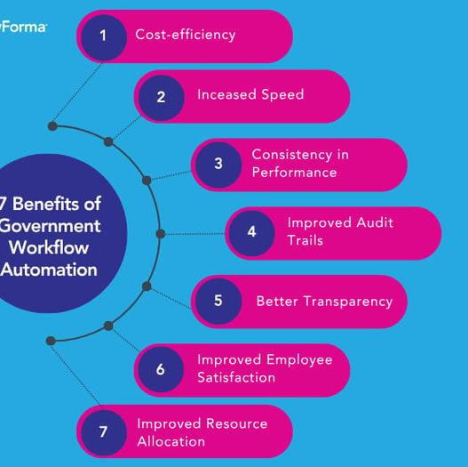
Why Current Systems Are Not Enough
• The current system only tracks the file status at a particular office. • There is no mechanism to predict delays or expected completion time • Bottlenecks in the workflow are not identified in advance • Workload is not balanced across officers or departments • Issues are addressed only after delays occur • Overall, the system remains reactive rather than proactive

Slide 4
Our Solution: FlowGov AI
An AI-powered workflow optimization system for file processing • Predicts expected file processing time using historical data • Identifies steps in the workflow that are prone to delays • Recommends the most suitable officer or routing path for each file • Ensures balanced workload distribution across departments • Improves overall transparency, efficiency, and decision-making

Slide 5

System Workflow
• File details are entered into the system at the time of submission • The AI model predicts the total expected processing time • Workflow steps with a high risk of delay are identified in advance • The system recommends the most suitable officer or routing path • A centralized dashboard displays real-time insights and status updates

Slide 6
Technology & AI Stack
• Python used as the core development language • LightGBM / XGBoost for accurate file processing time prediction • Random Forest for classifying delay-prone workflow steps • FastAPI used to build a fast and scalable backend API • Streamlit for an interactive and user-friendly dashboard • Synthetic data generated to train and validate the models

Slide 7
Impact & Benefits
• 30–50% reduction in overall file processing time • Significant reduction in pending files and departmental backlogs • Improved workload balance across officers and departments • Higher transparency through real-time tracking and insights • Increased citizen trust due to faster and more predictable outcomes

Slide 8
Scalability & Future Vision
• Initial deployment begins at the district level for controlled implementation • Gradual expansion to state-level and national-scale systems • AI models continuously learn and improve using real operational data • Aligns with Digital India’s ₹14,903 crore transformation plan • Enables a scalable, efficient, and future-ready governance system

